Slide 1

GoRider: A Vehicle Rental Service
Team Members
1: Aman Maurya (2001330100041)
2: Aditya Singh (2001330100026)
3: Aashutosh Shukla (2001330100006)
4: Abhinav Sheoran (2001330100011)

Slide 2
Content
Tools and Technologies
Problem Statement
Aim & Objective
Working Model
Results
Links

Slide 3
Tools and technologies
Frontend:- Html, CSS, Javascript.
Backend:- Node.js, Express.js, MongoDB.
Visual Studio Code Editor
Version Control System :- Git
GitHub

Slide 4
Problem statement's
The problem is that many people require access to reliable transportation for various purposes, but not everyone owns a vehicle or has access to one. There is a need for a cost-effective, convenient, and efficient vehicle rental service that offers a wide range of vehicle options to cater to the diverse needs of customers. The solution should provide affordable and convenient vehicle rental options for people who require transportation for different purposes and offer a variety of vehicle options to meet the varying needs of customers.

Slide 5
Aims & objectives
Now let me allow introducing the objectives of car rental management system:
Faster Process – To make sure a user gets his desire car as early as possible; the vehicle rental management system will provide a faster response to complete the process.
Minimize paperwork – As all the system is computerized, there is no need to fill any application form for renting purpose. So, the paperwork will be very less.
Centralized – All types of data and the activities related to the system will be kept in a single place so that it is easy to monitor the system and provide the customer the best service.

Slide 6
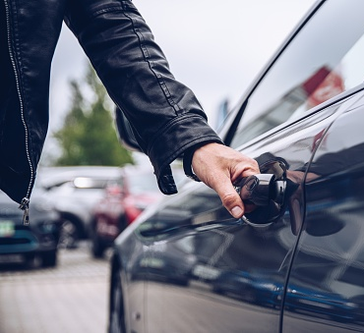
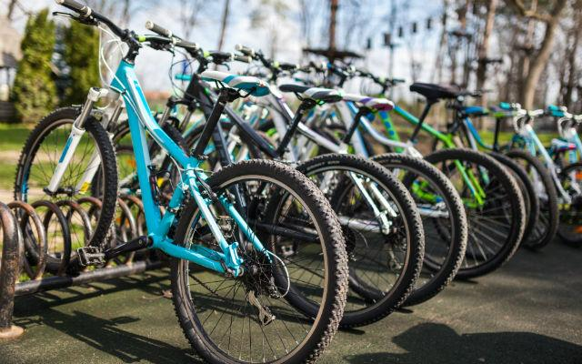


Slide 7
How Our Service Works
For the customer’s side, an app-based car rental software makes it easier for them to book a car at their convenience. Here is how the software works.
Book a Car
Visit the website. Search for the car, select the time duration, and initiate booking.
Upload License
Before the booking is confirmed, customers need to upload their valid driver’s license to make sure they are legally authorized to drive.
Unlock the Car
As soon as the booking is confirmed, customers will receive car details through an SMS. At the pick-up location, they can unlock their car via the rental app.
Return the Car
Once the trip ends, customers can drive back the car to the same location and fend their trip.

Slide 8
Benefits of our rental service
This online car rental solution is fully functional and flexible.
It is very easy to use.
This online car rental system helps in back-office administration by streamlining and standardizing the procedures.
It saves a lot of time, money and labour.
Eco-friendly: The monitoring of the vehicle activity and the overall business becomes easy and includes the least of paperwork.
The software acts as an office that is open 24/7.
It increases the efficiency of the management at offering quality services to the customers.
It provides custom features development and support with the software.

Slide 9
Continue…

